Slide 1
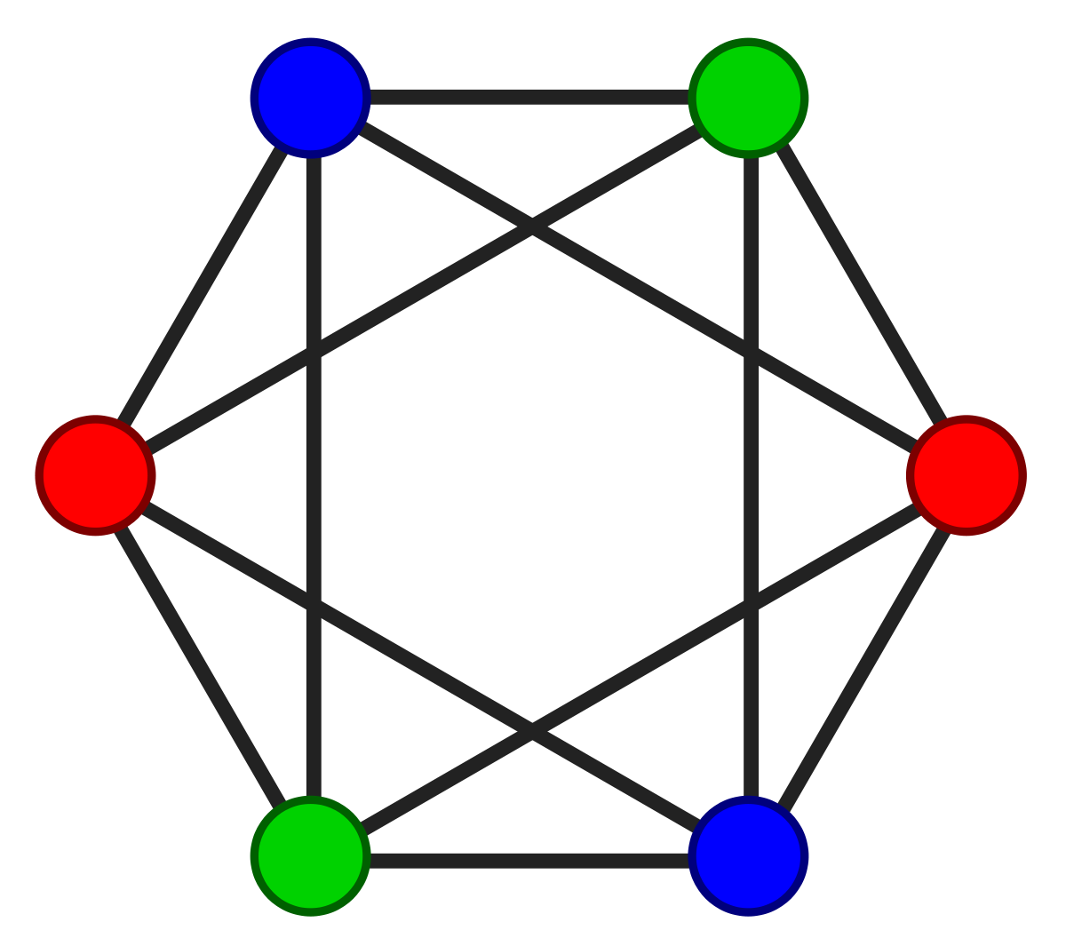
Exams Made Easy (EME)
An app for gaining insights from relational data and organizing exam schedules

Slide 2
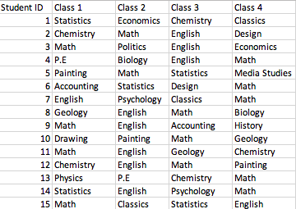
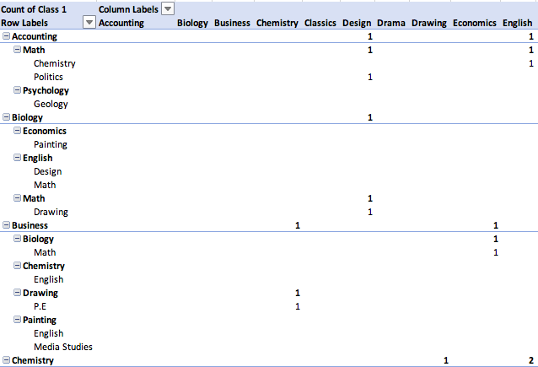
About the Application
Relational data -> Pivot Tables?
Hard to gain insights from relational data
Uses networks/graphs to visualize information
Creates an optimal timetable for exams given the dataset
Many schools may lack resources and skilled people to efficiently do this
Graph colouring to solve this

Slide 3
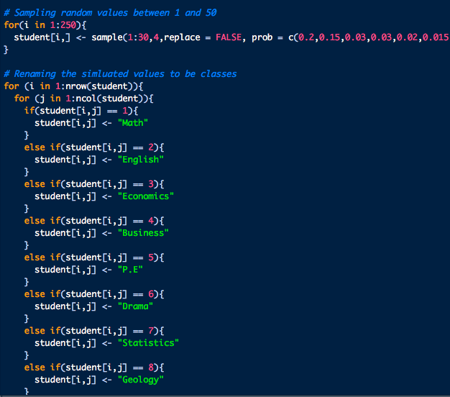
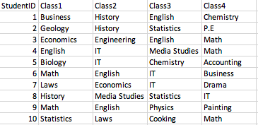
Data Generation
Unable to find database of exam information – schools tend to have strict regulations on what data they can make public
Used R to simulate data – tried to assign probabilities that reflect real life (I,e math and English more common than painting)
Outputs into a CSV format

Slide 4

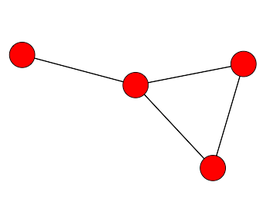
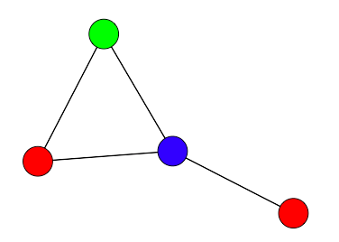
Visualisation of the data
Let a node represent a class
An edge (relation) between 2 classes if > 1 student is taking both of them
We let a node colour represent a timeslot
Colour the graph such that no two adjacent vertices are the same colour => no timetable clashes (two classes will have different timeslots if >1 student is taking both)
Use the least amount of colours to do this => least number of timeslots needed to create a timetable with no clashes
Least amount of colours such that adjacent vertices are different colours
C
A
B
Class A
>1 student taking both class A and class B
D

